Slide 1
Morphology of Vegetative Structures I & II
Roots, stems & leaves
J&C pp. 65-73

Slide 2
Roots (and stem parts that LOOK like roots but aren’t)
Quite uniform in appearance and therefore cannot be used alone to identify a plant.
Can be used to differentiate annual vs. perennial.
Fibrous: all portions of root system about the same thickness and well branched.
Taproot: with a major root enlarged and growing downward

Slide 3
Root Look- Alikes
Stolon= above ground horizontal stem (NOT a root; the roots develop downward from the stolon)
Rhizome= below ground horizontal stem (NOT a root; the roots develop downward from the rhizome)

Slide 4
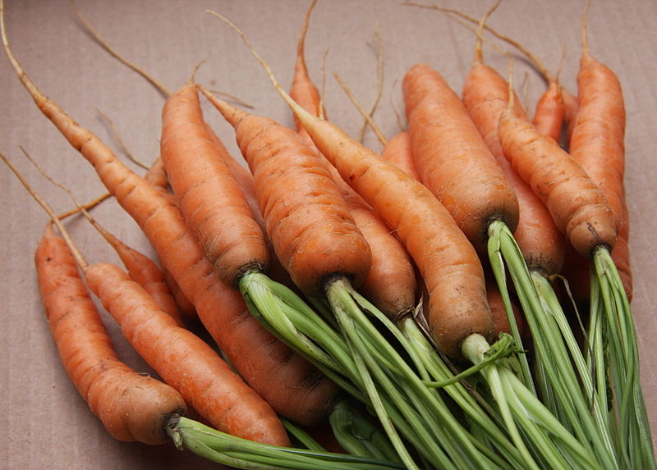
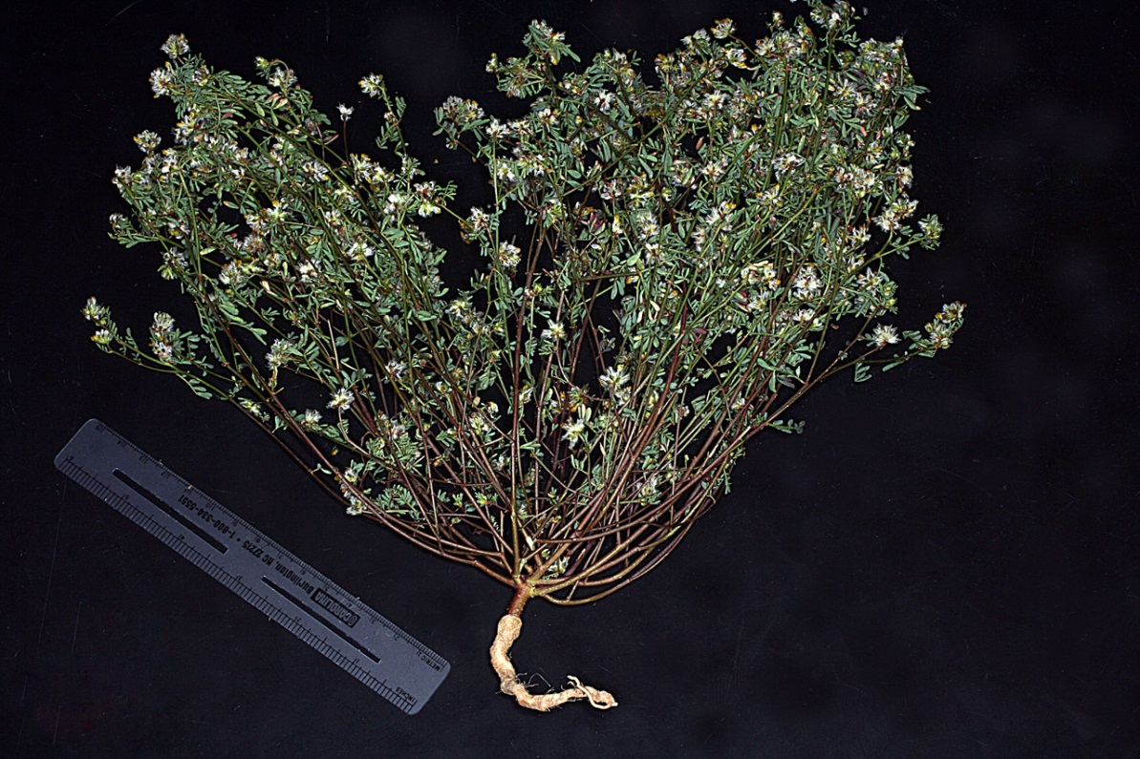
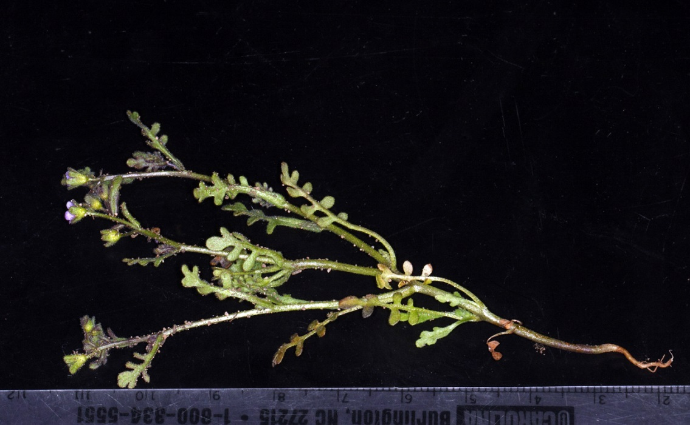
Taproots
Daucus carota
Many eudicots have taproots.
Eucrypta micrantha
Dalea brachystachya

Slide 5
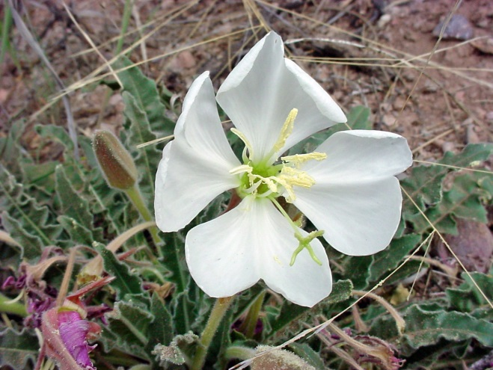
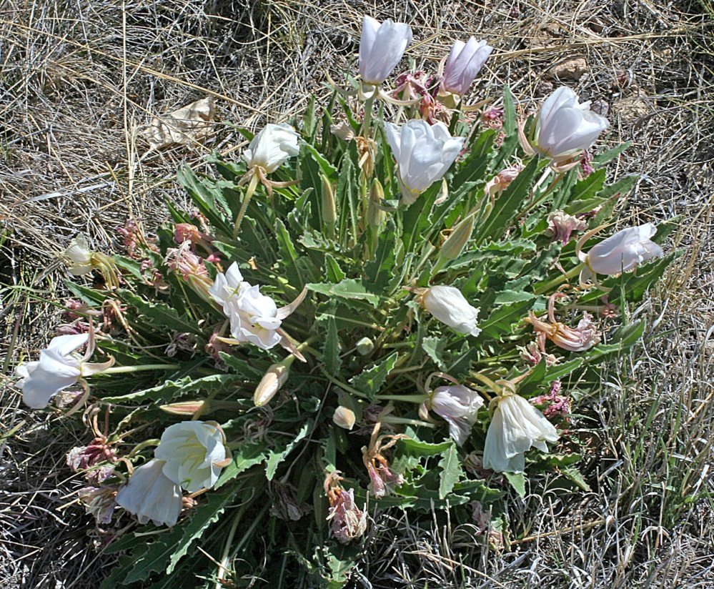
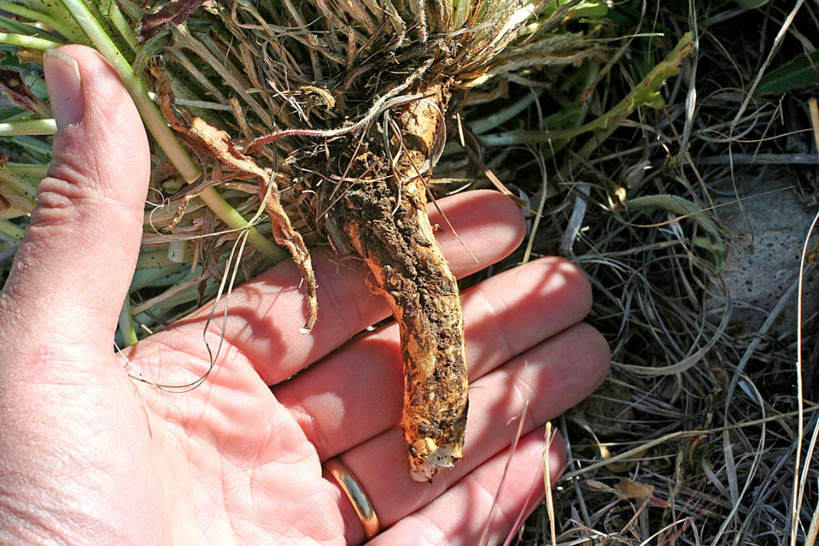
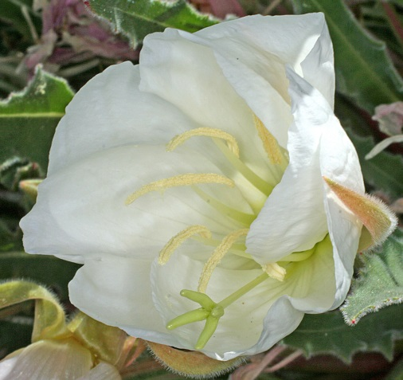
Oenothera caespitosa (annual or perennial?)

Slide 6
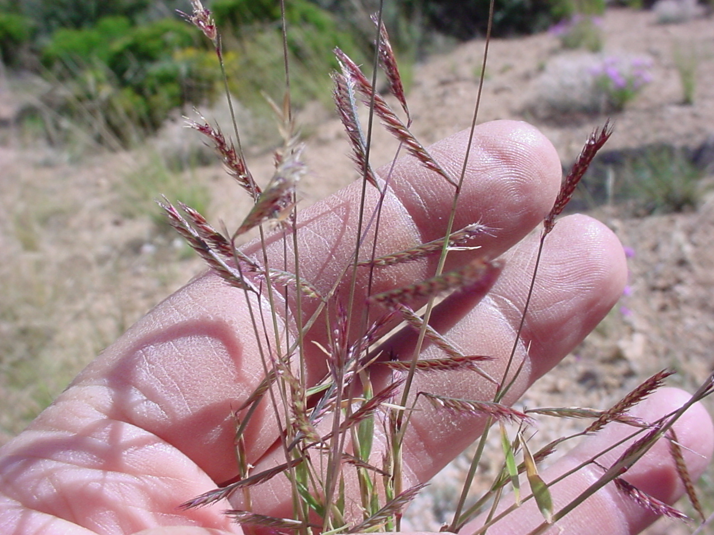
Bouteloua barbata
Six weeks grama

Slide 7
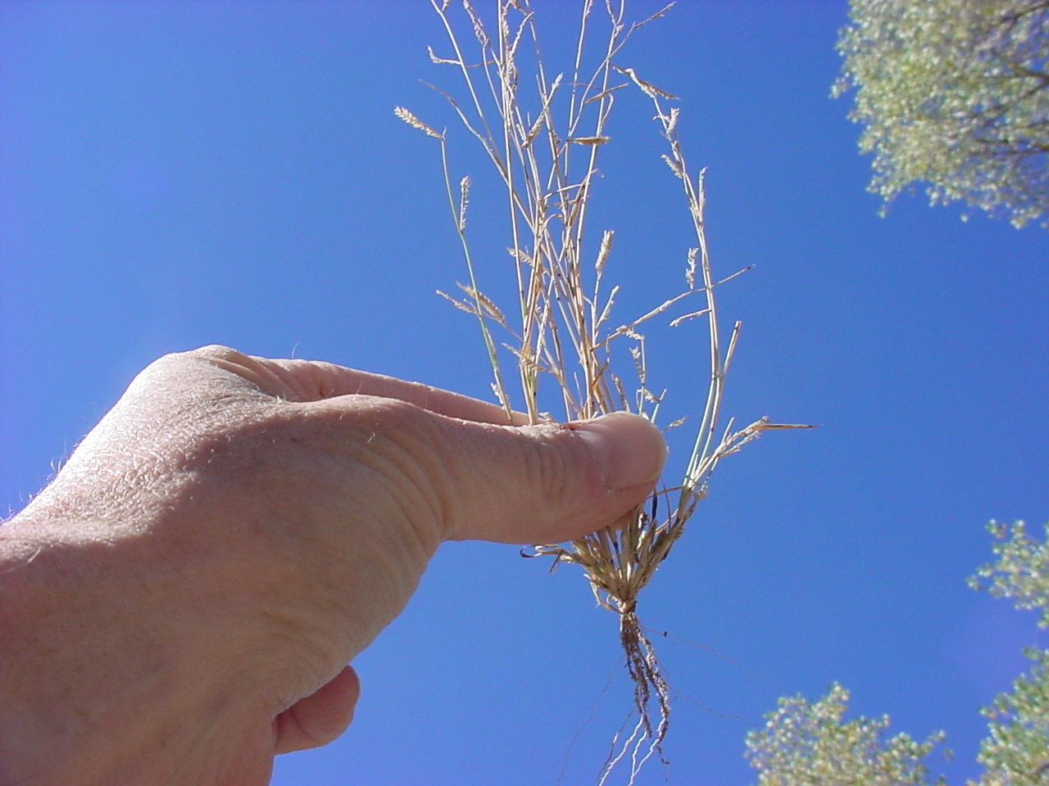
Bouteloua barbata (fibrous, annual or perennial?)

Slide 8
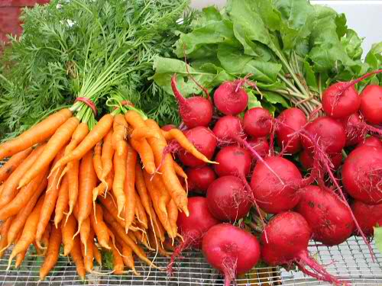
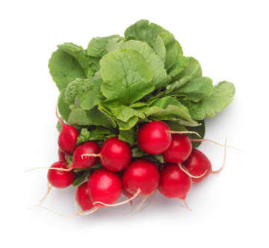
Modified Roots
Food storage roots: cross sections of these roots reveal multiple rings of secondary growth
Beets
Radishes
Carrots

Slide 9
Modified Stems
Keep in mind…
“…stems have leaves at nodes, with internodes between the nodes, and buds in the axils of the leaves…”
“…roots have no leaves, nodes, or axillary buds.”
“Biology” 9th ed. Raven et al

Slide 10
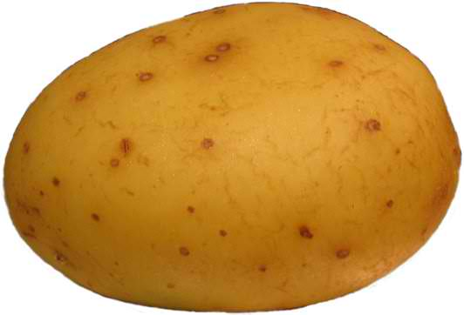
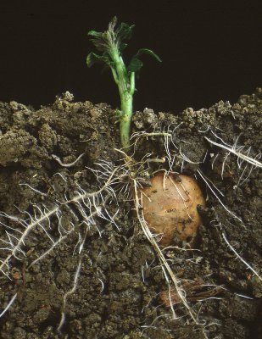
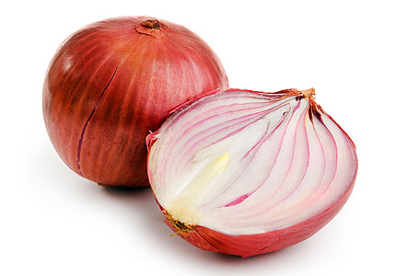
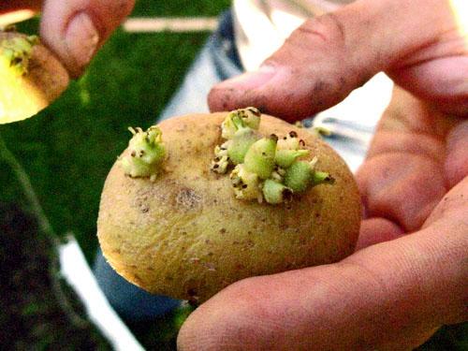
Modified Stems
A potato is the terminal, storage portion of a rhizome (underground stem) known as a tuber.
Onion bulb is made up of fleshy leaves attached to small knoblike stem.
Roots come from here

Slide 11
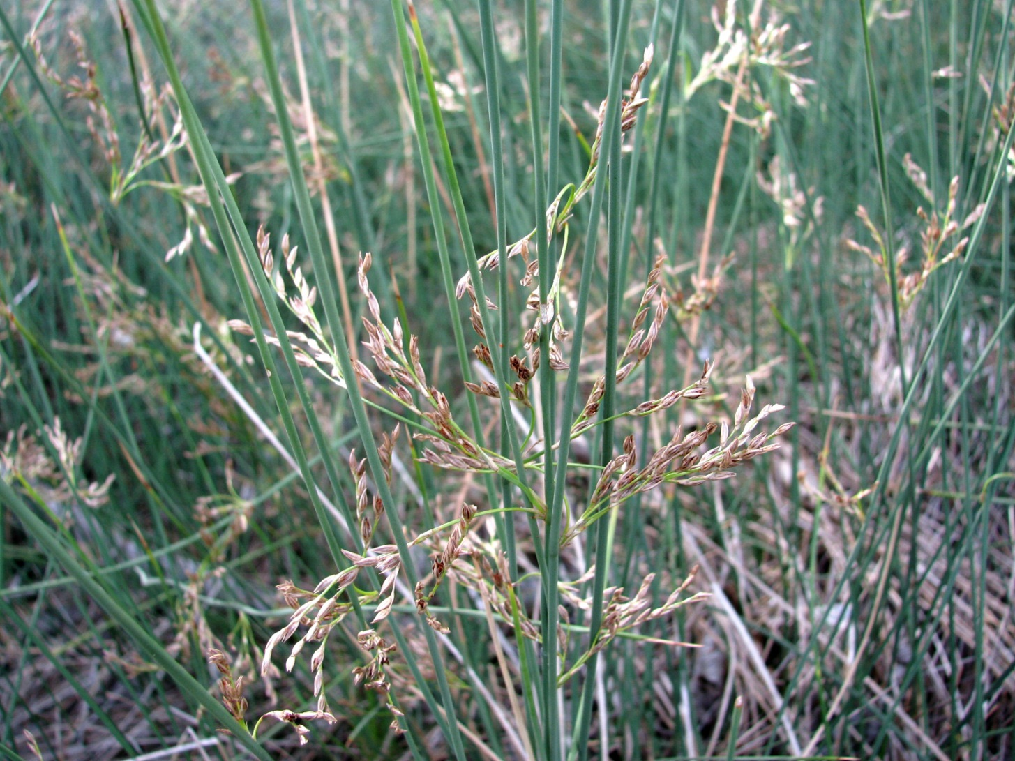
Juncus arcticus

Slide 12
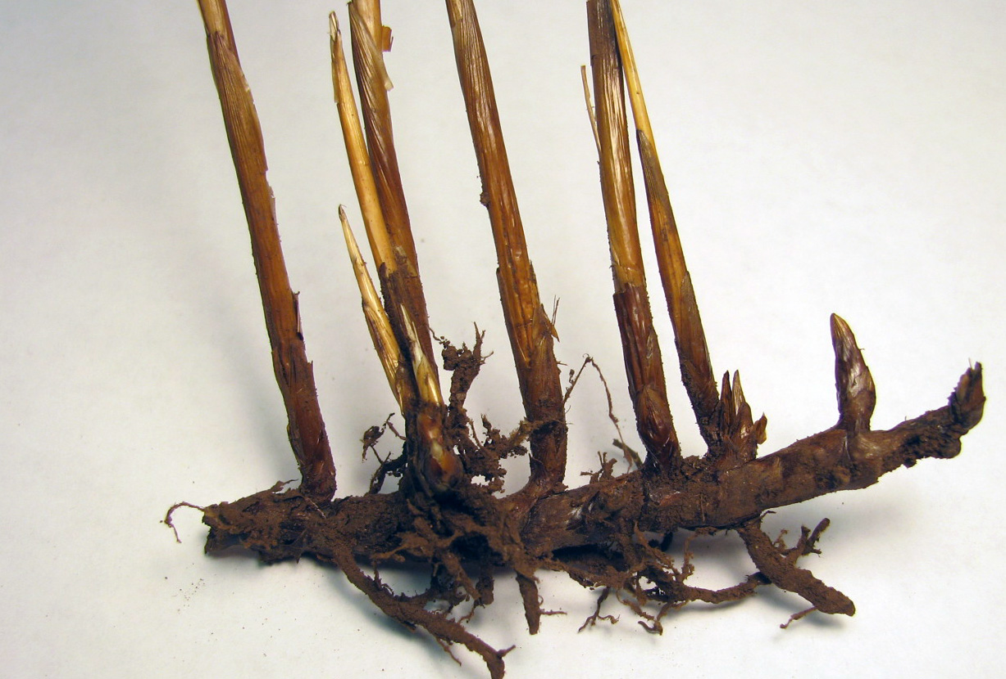
Juncus arcticus (rhizome= underground horizontal stem)

Slide 13
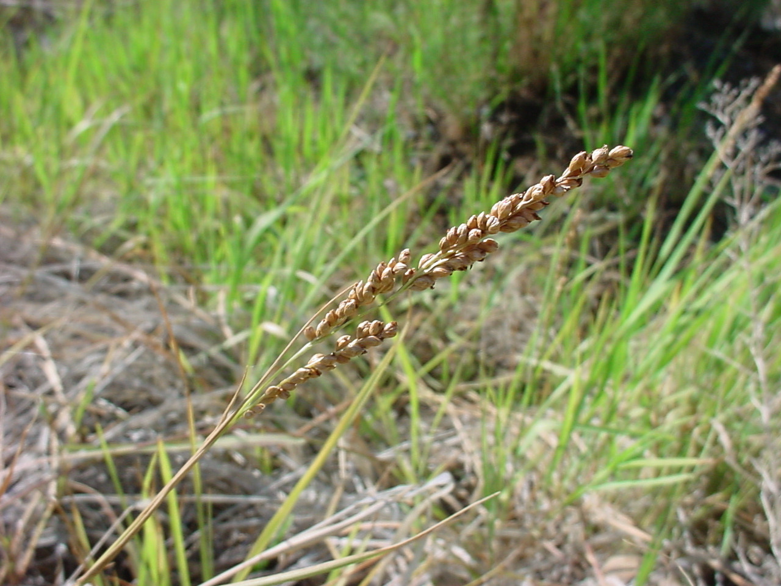
Hopia obtusum

Slide 14
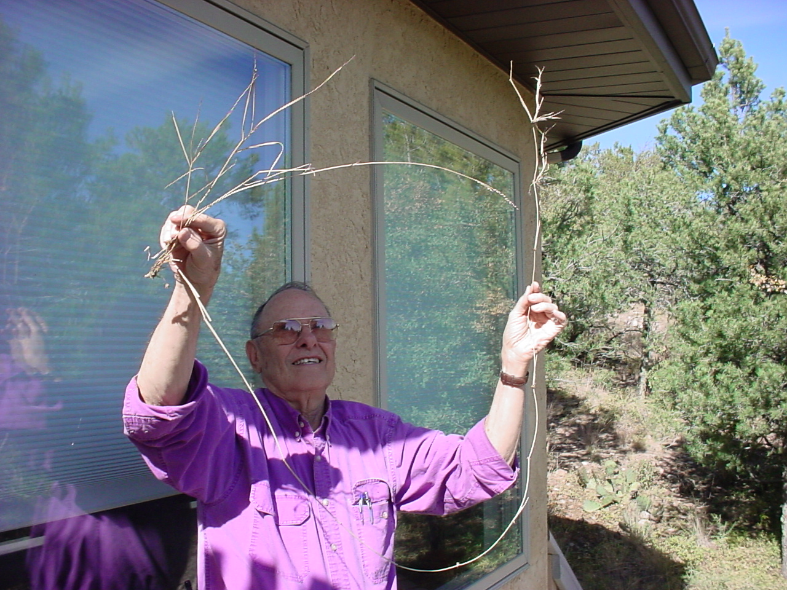
Hopia obtusum (stolon= “runner,” above ground horizontal stem)

Slide 15
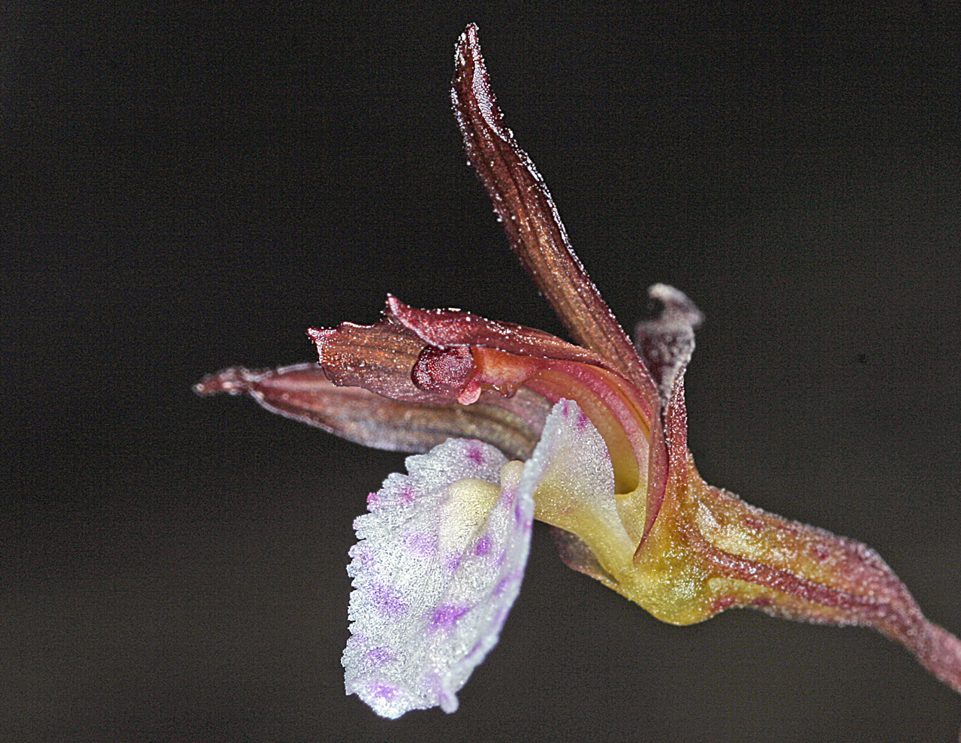
Corallorhiza wisteriana (Roots: none, from a branched “coralloid” rhizome)

Slide 16
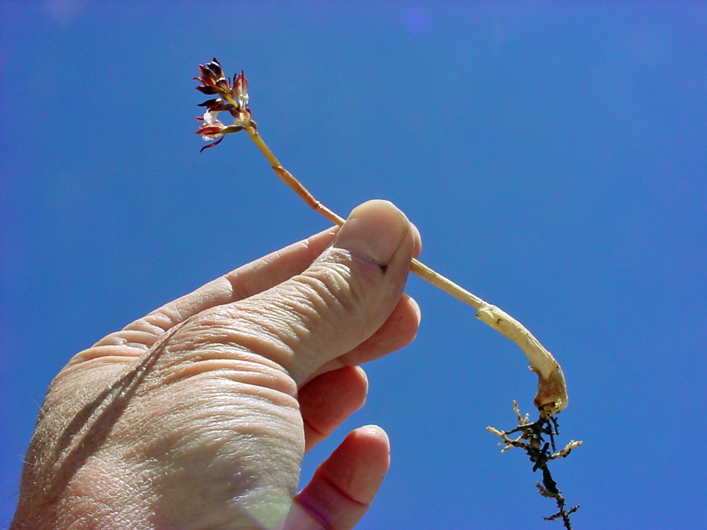
Corallorhiza wisteriana: extensive mycorrhizae

Slide 17
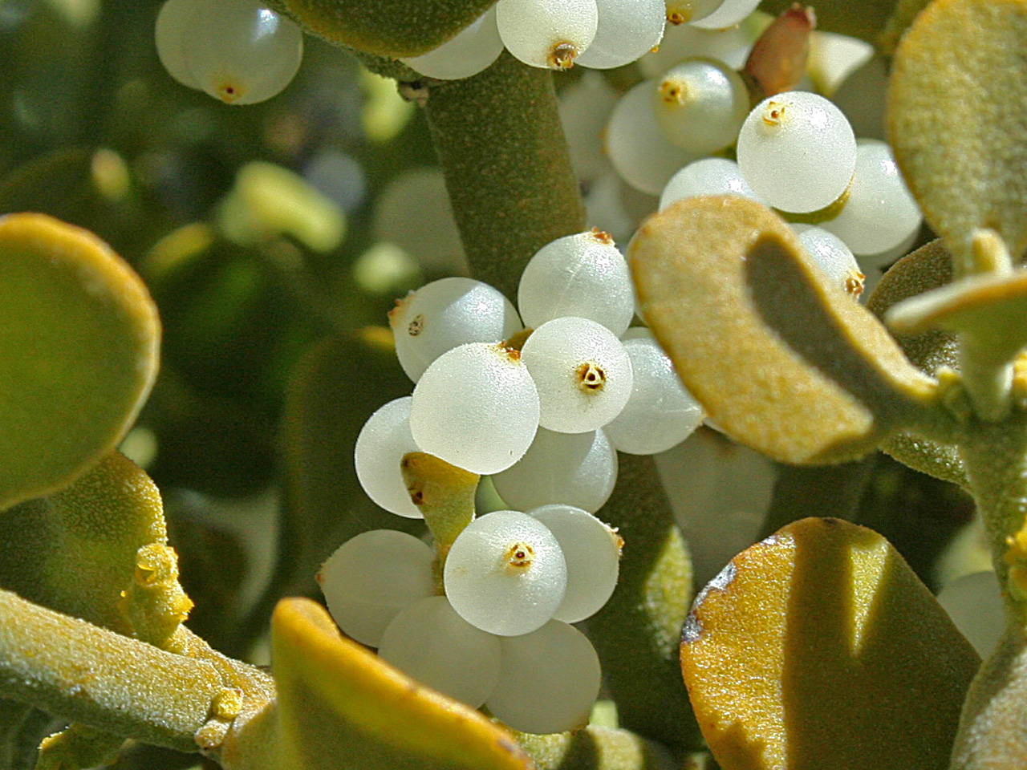
Phoradendron coryae (haustoria)

Slide 18
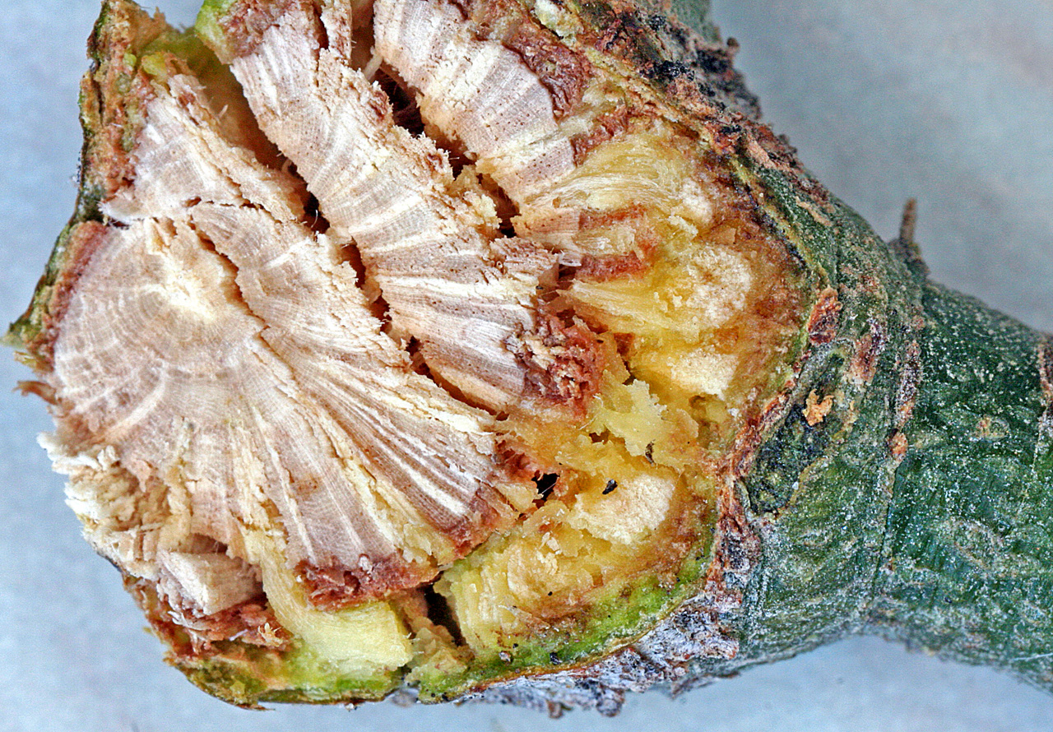
Phoradendron coryae

Slide 19
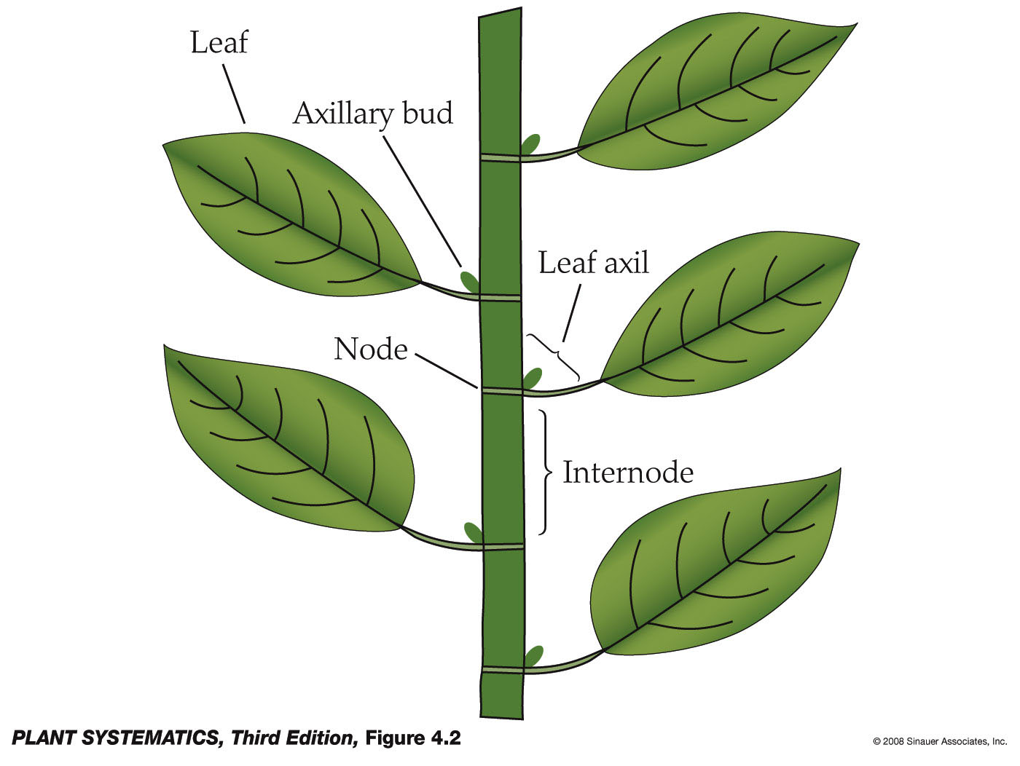
Stem– the axis of a plant

Slide 20
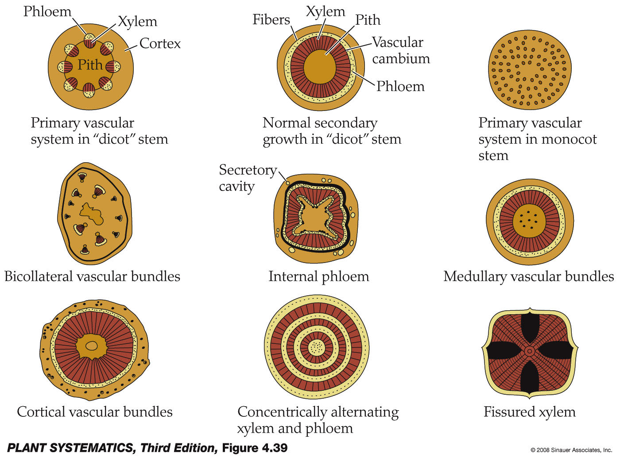
Xylem & Phloem in Stems

Slide 21
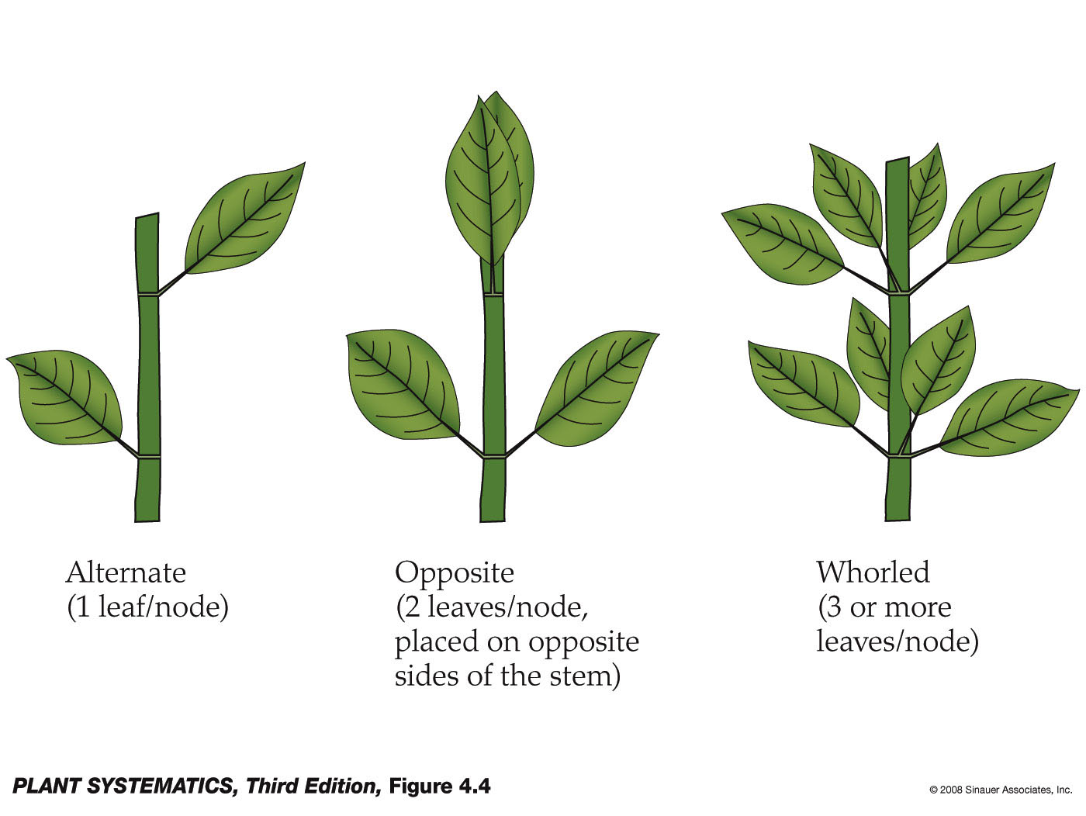
Leaf Arrangement

Slide 22
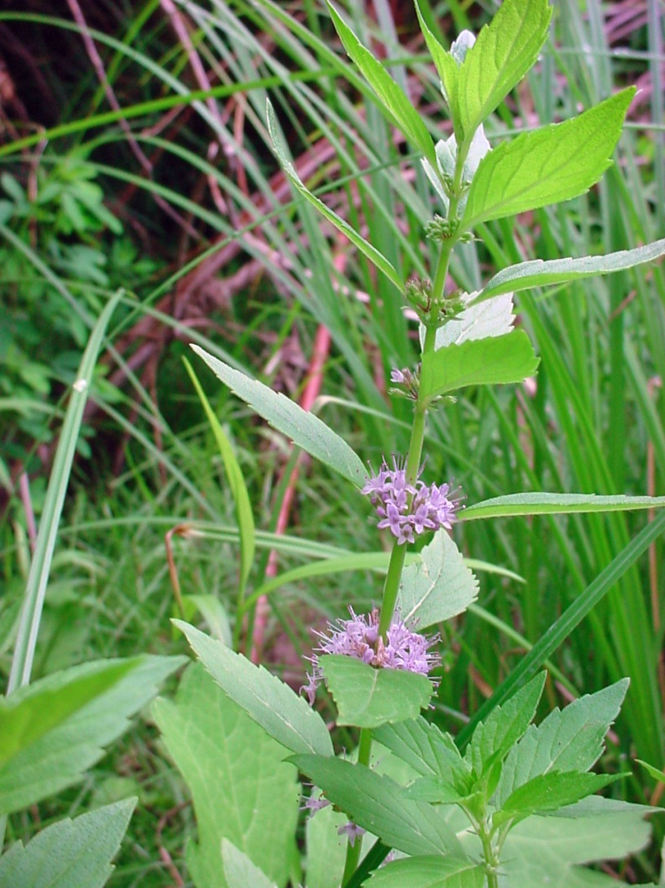
Mentha arvensis (leaves opposite)

Slide 23
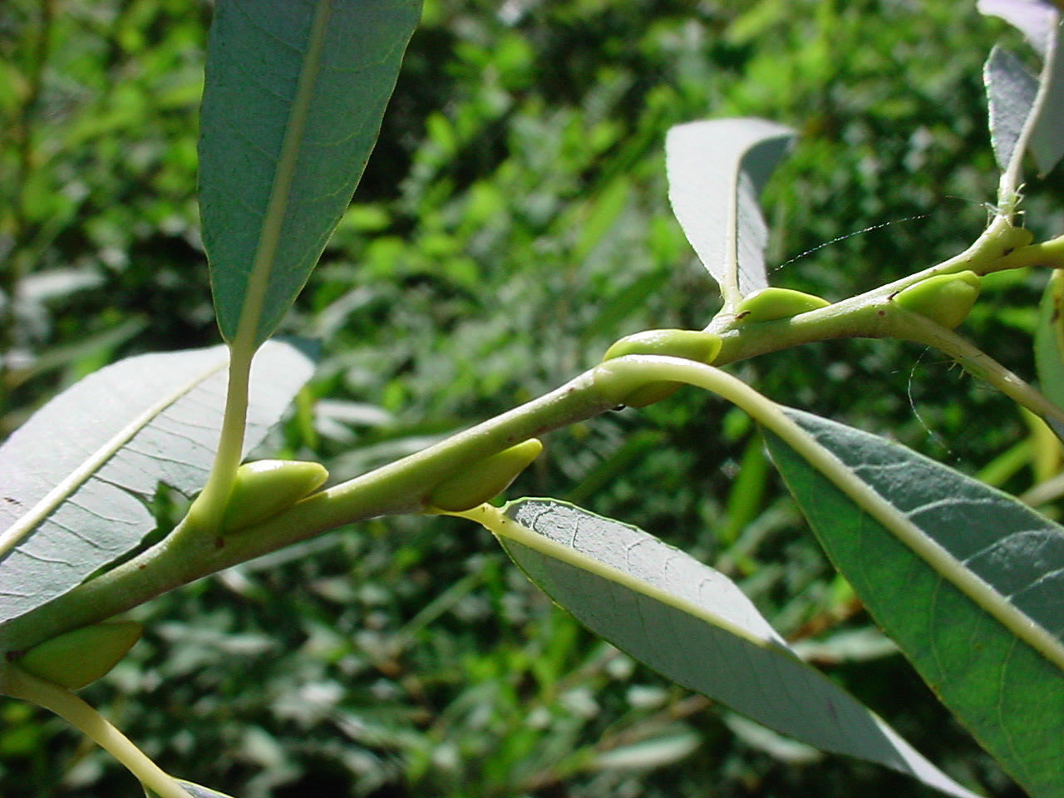
Salix irrorata (leaves alternate)

Slide 24
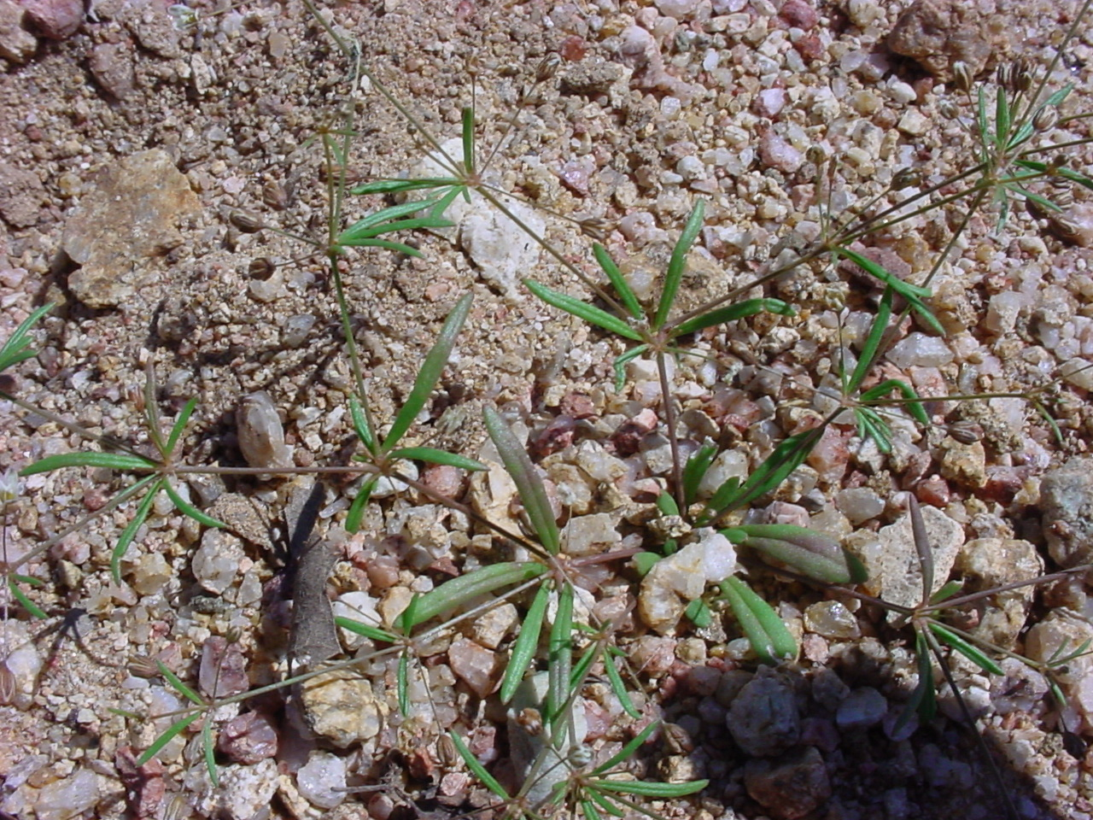
Mollugo verticillata– whorled leaves

Slide 25
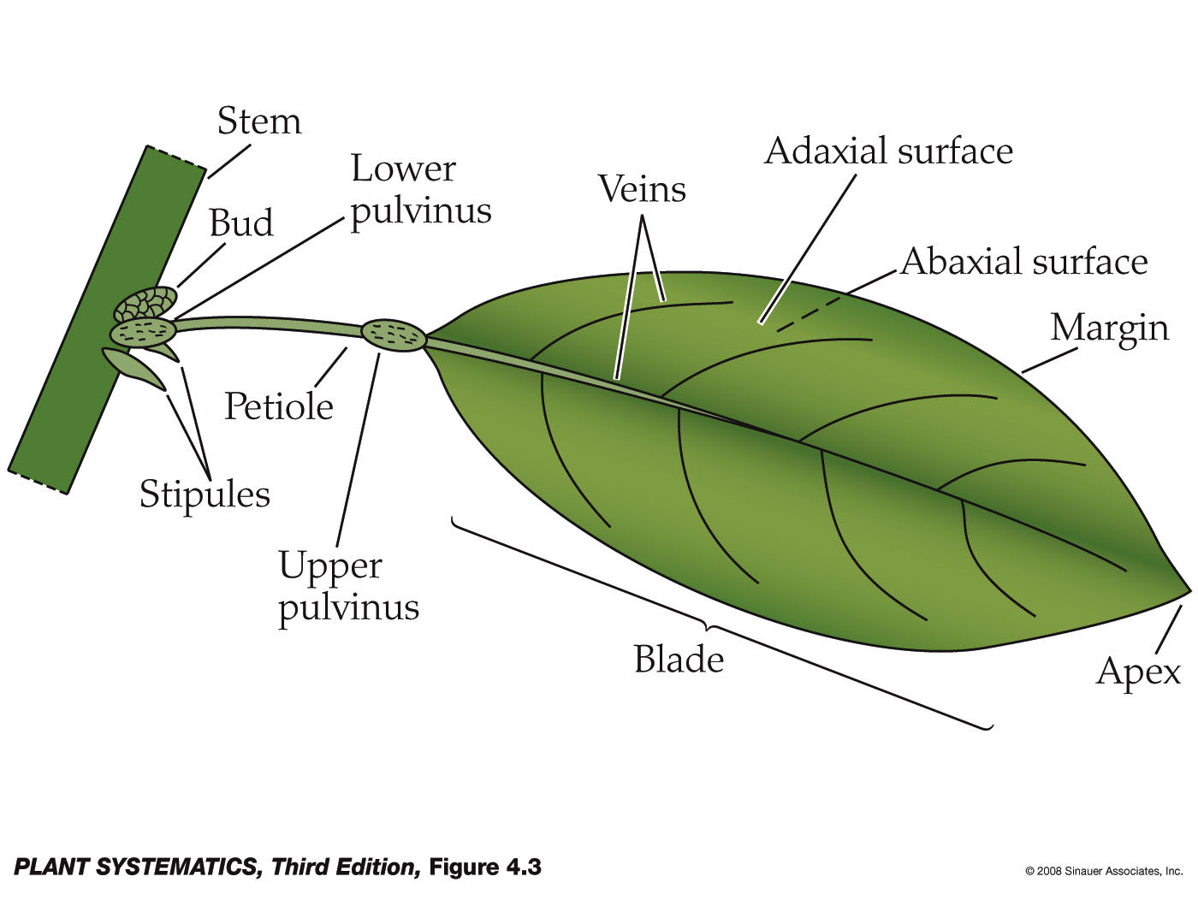
Leaf Complexity-- Simple

Slide 26
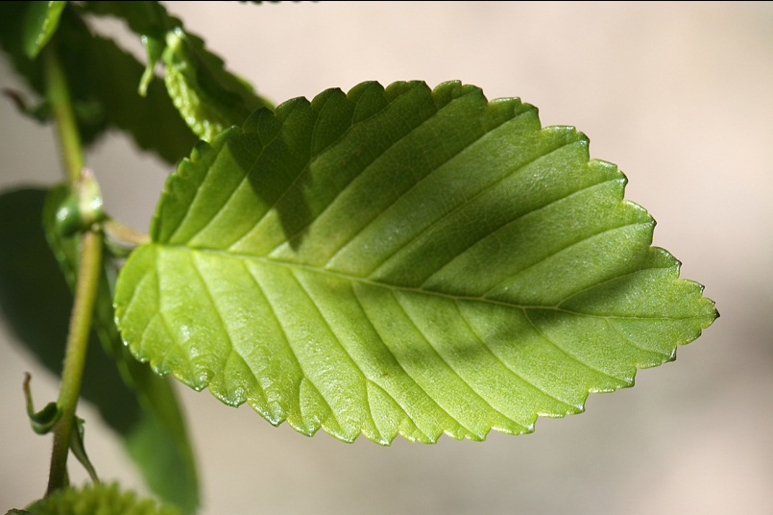
Ulmus pumila– simple leaf

Slide 27
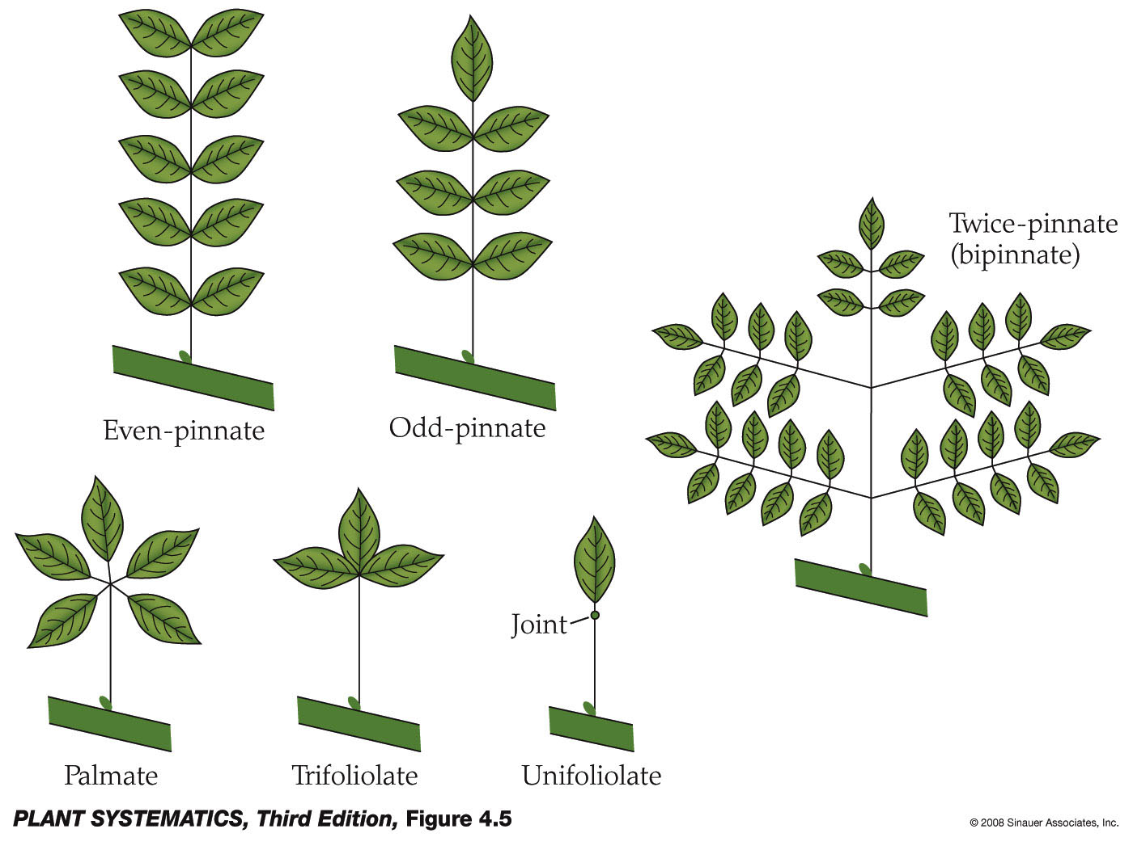
Leaf Complexity-- Compound

Slide 28
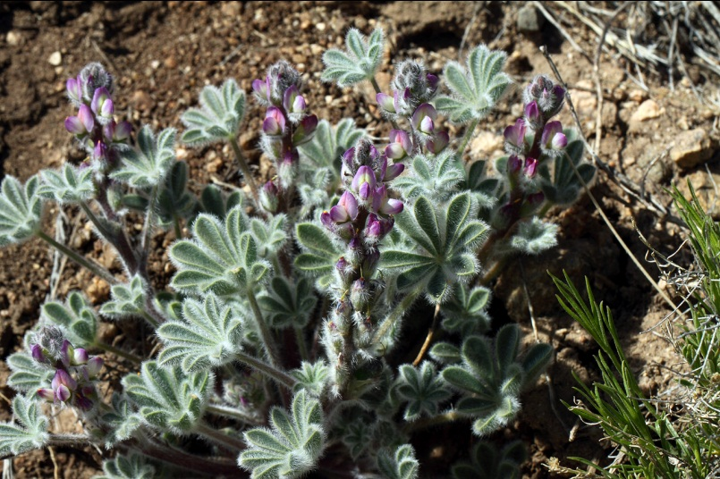
Lupinus concinnus– compound leaves, palmate arrangement

Slide 29
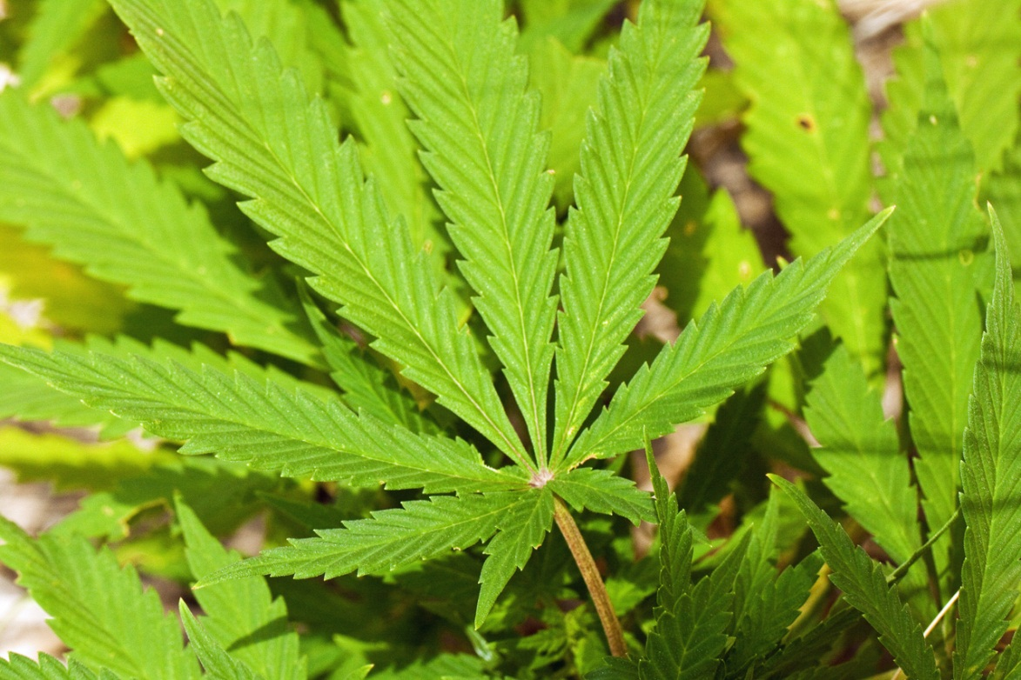
Compound leaves, palmate arrangment
I’m sure nobody knows the ID of this plant…!?

Slide 30
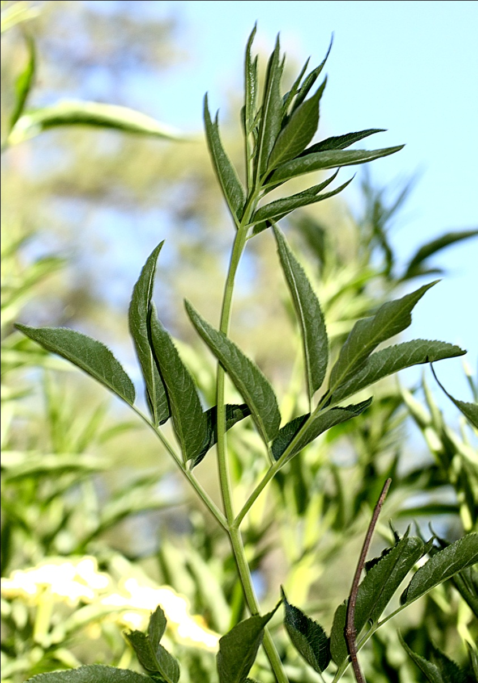
Sambucus coerulea– compound leaves odd pinnate

Slide 31
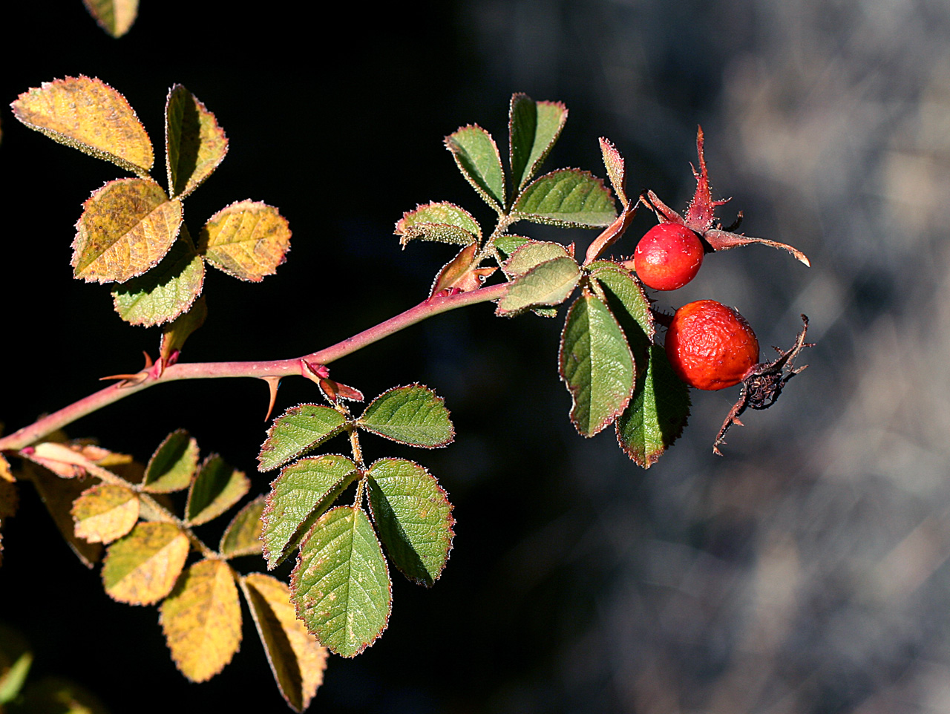
Rosa woodsii– compound leaves, odd pinnate with obvious stipules
Stipule= paired appendages on either side of the base of the leaf petiole

Slide 32
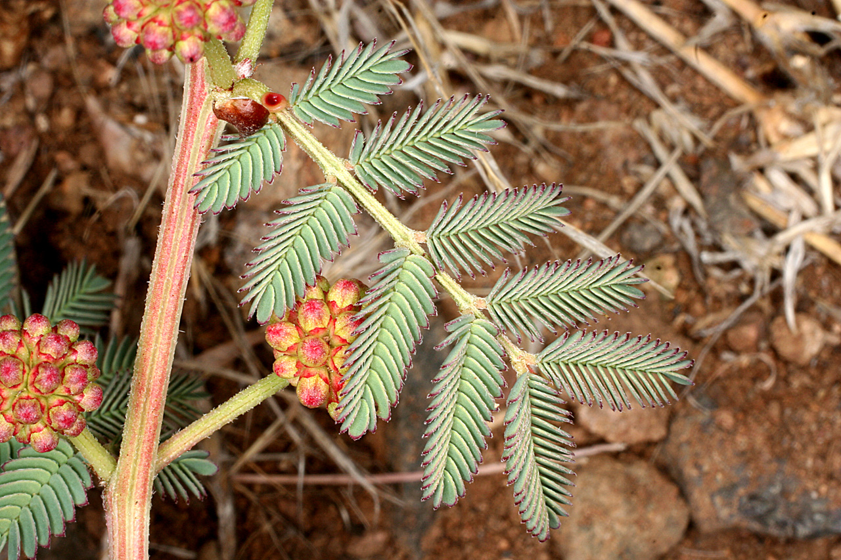
Desmanthus cooleyi– compound leaves, bipinnate

Slide 33
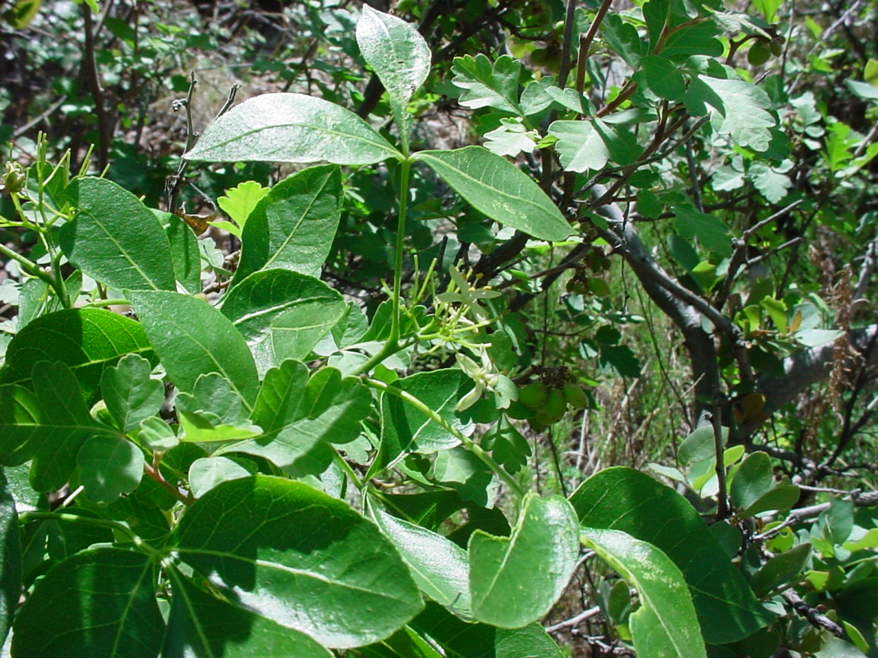
Ptelea trifoliata– trifoliolate leaf

Slide 34
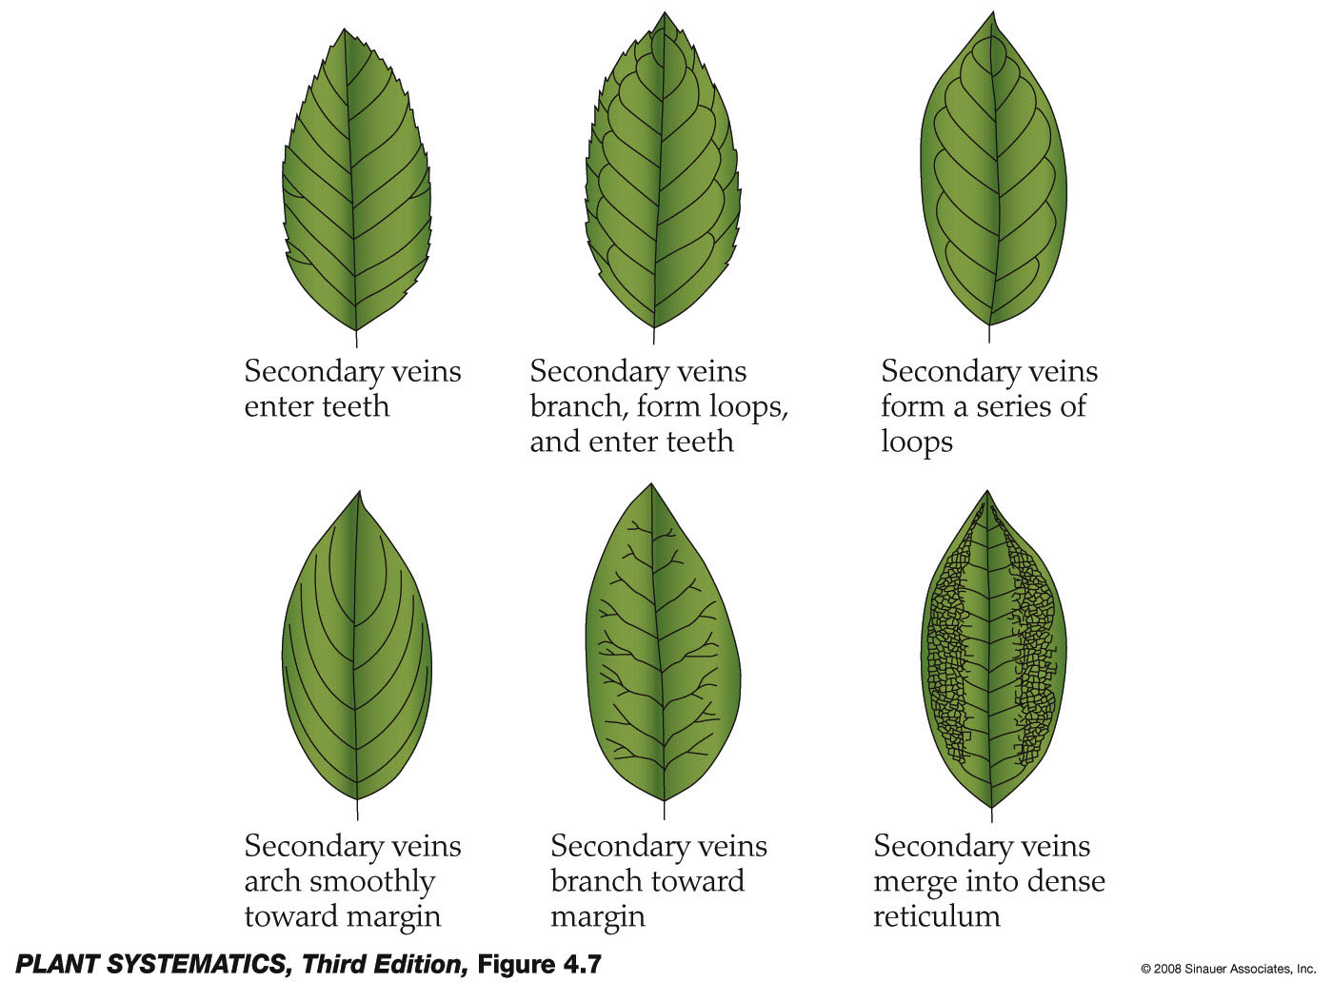
Venation-- Pinnate

Slide 35
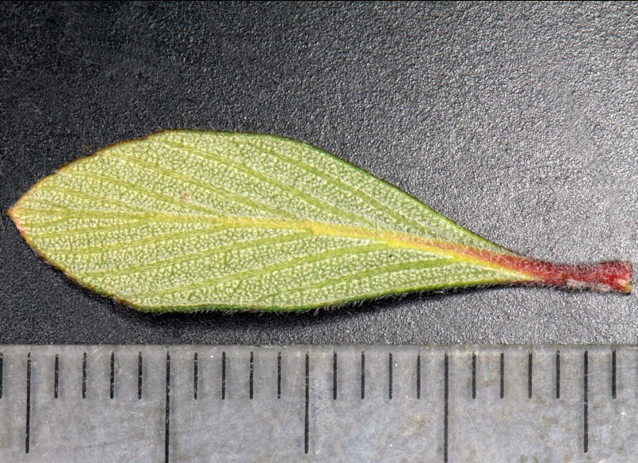
Cercocarpus breviflorus– pinnate venation

Slide 36
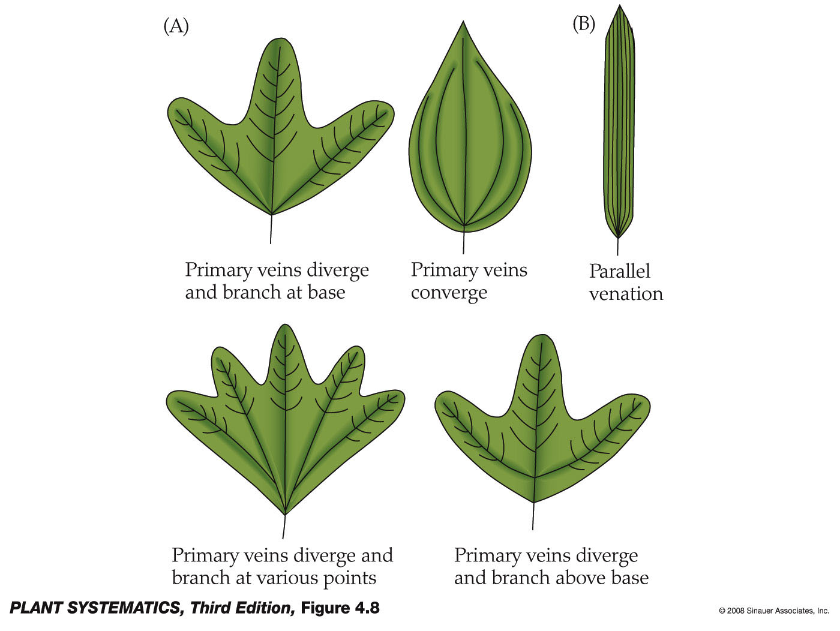
Venation– Palmate & Parallel

Slide 37
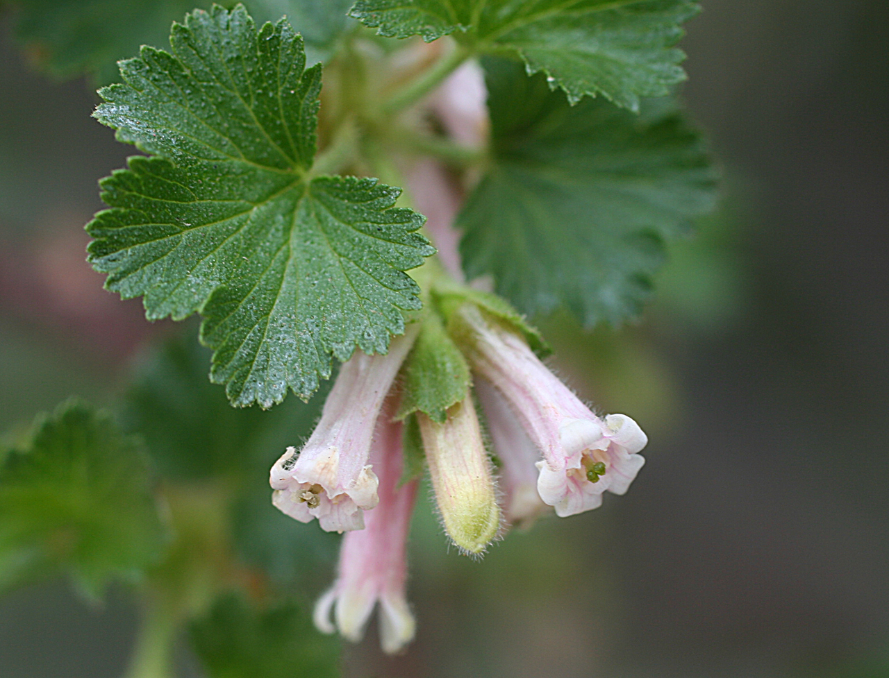
Ribes cereum– Palmate venation

Slide 38
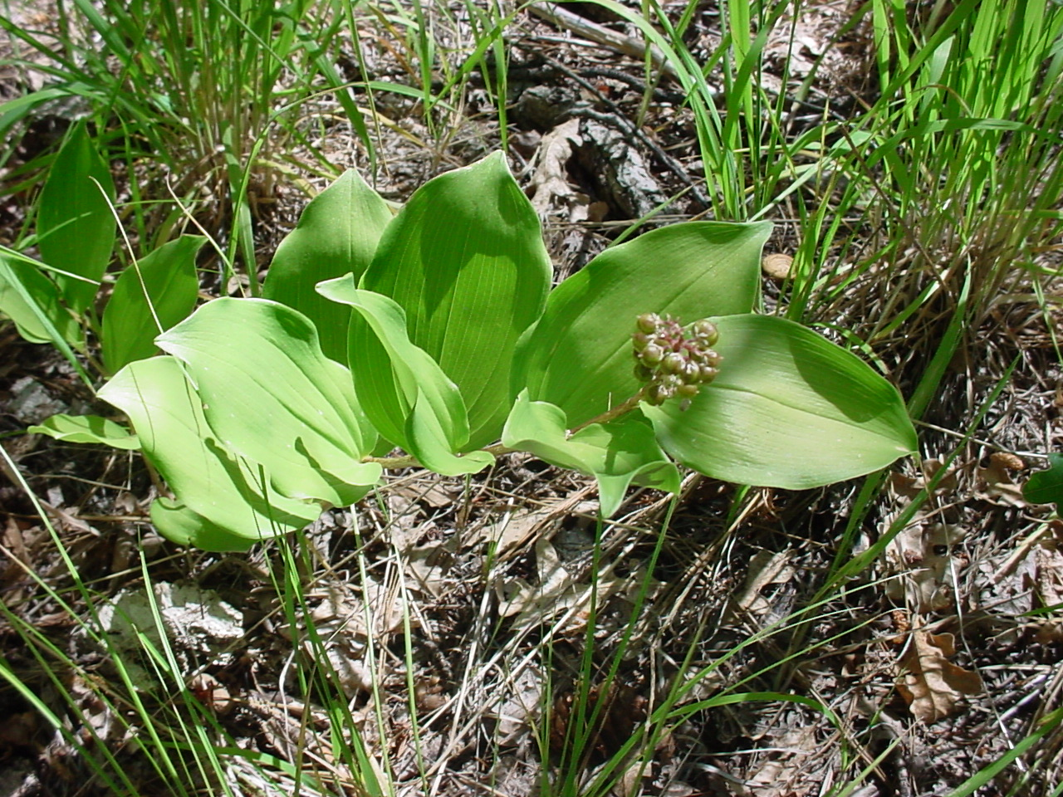
Maianthemum racemosum– Parallel venation

Slide 39
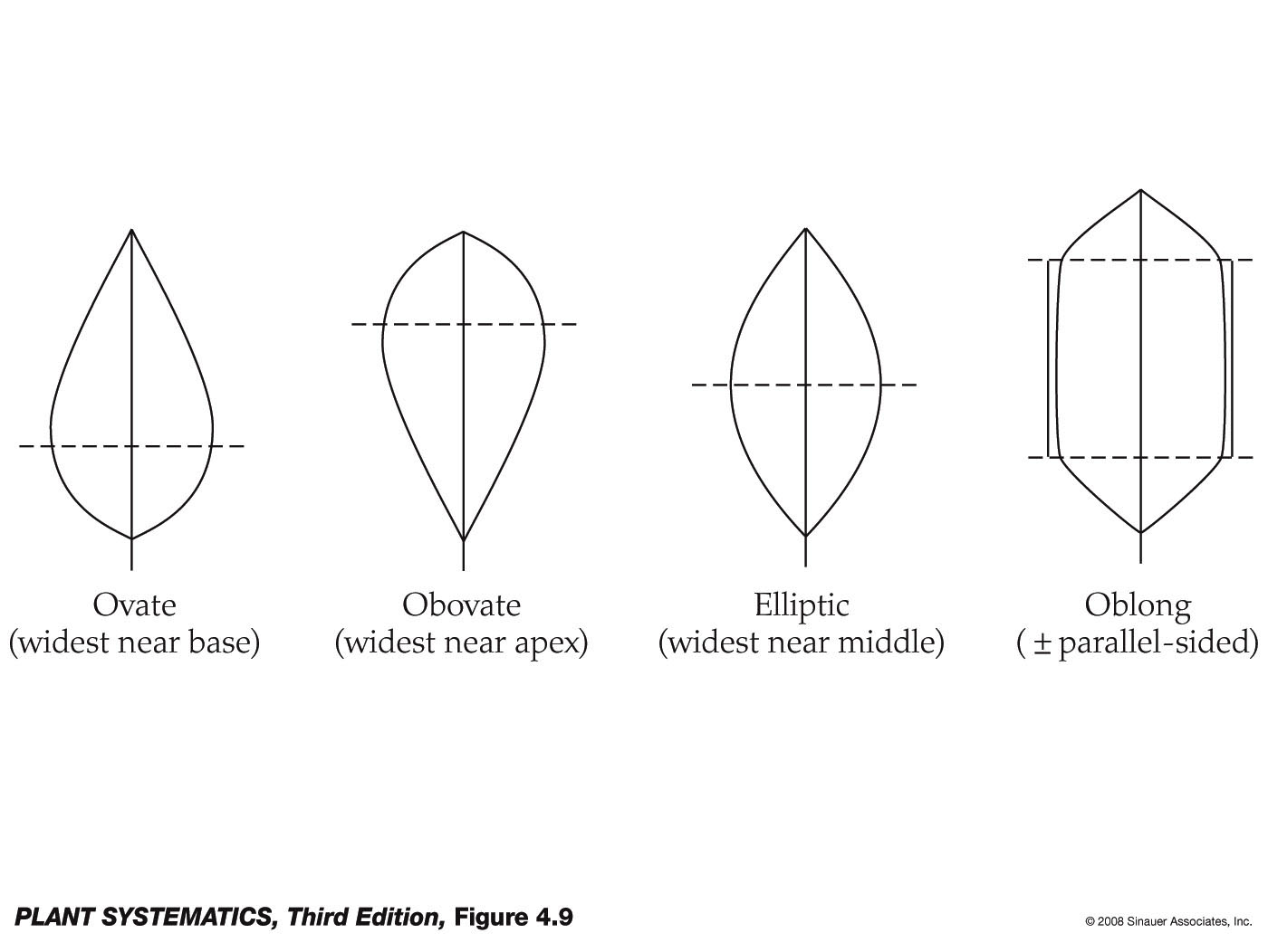
Leaf Shape

Slide 40
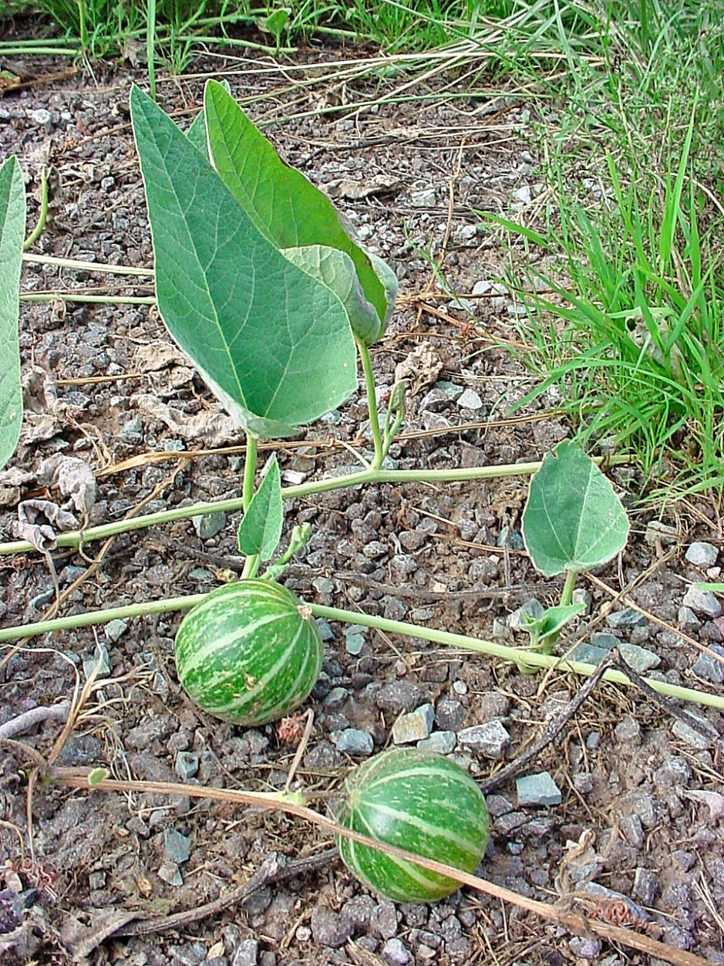
Cucurbita foetidissima– ovate leaf
Pepo= large berry with a thick rind derived from an inferior ovary; use restricted to the Cucurbitaceae
So…is a pumpkin a pepo? A watermelon?

Slide 41
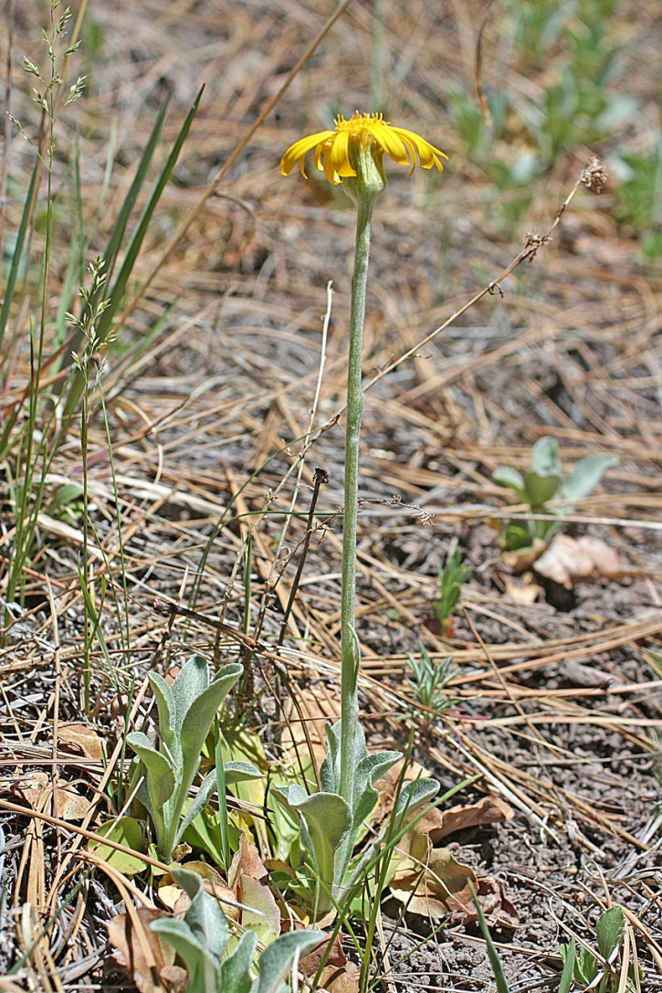
Senecio actinella– obovate leaf

Slide 42
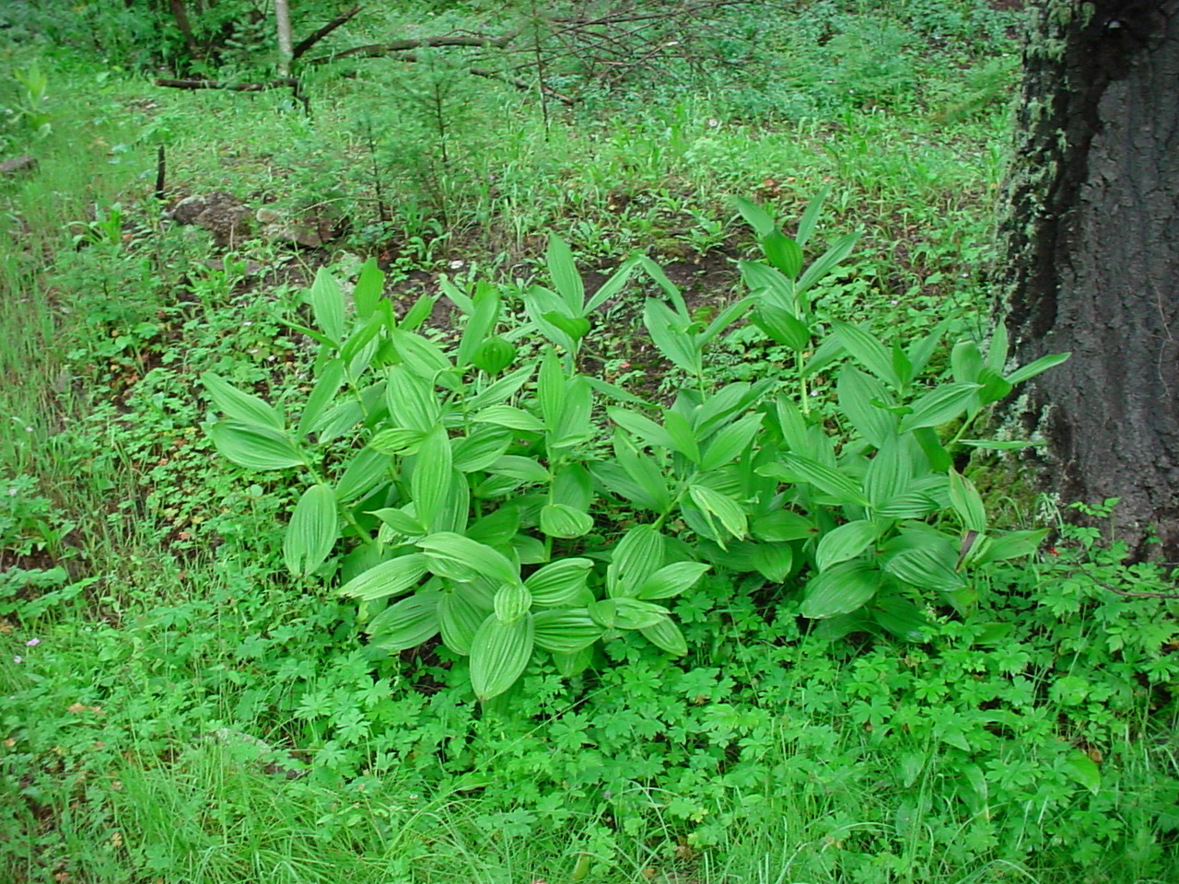
Veratrum californicum – elliptic leaf
Corn Lilly

Slide 43
Mollugo verticillata– oblong leaf

Slide 44
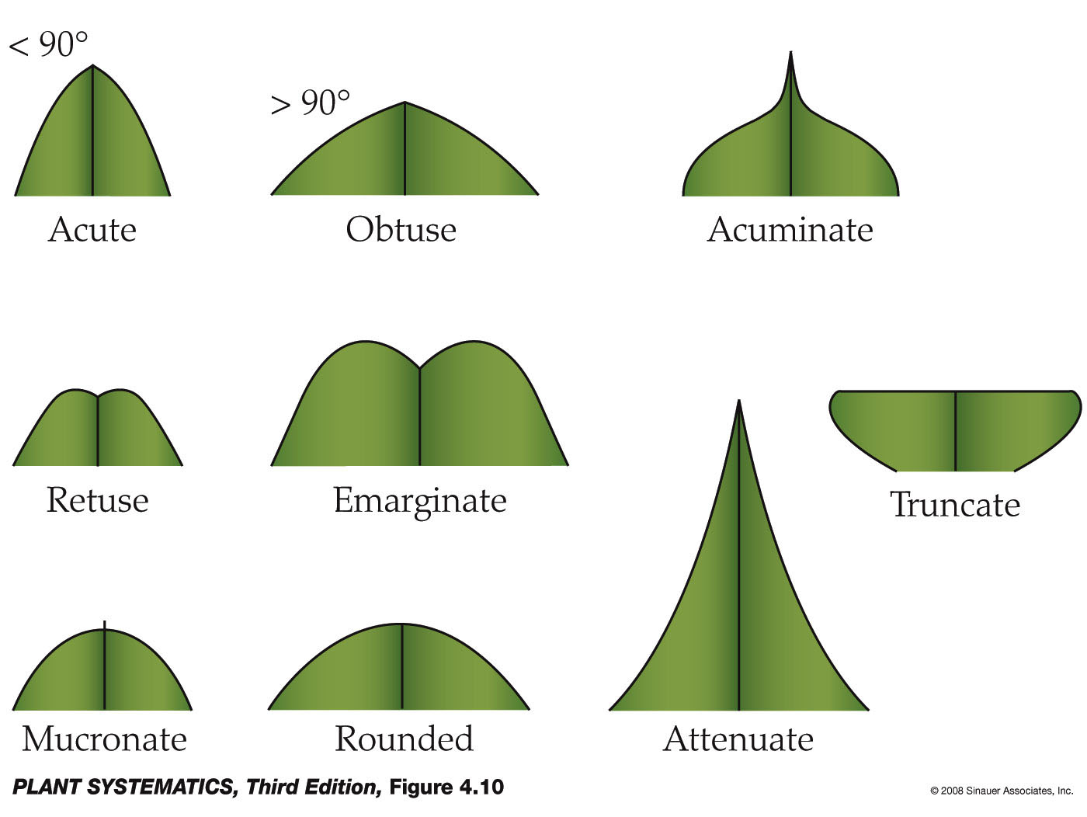
Leaf Apex

Slide 45
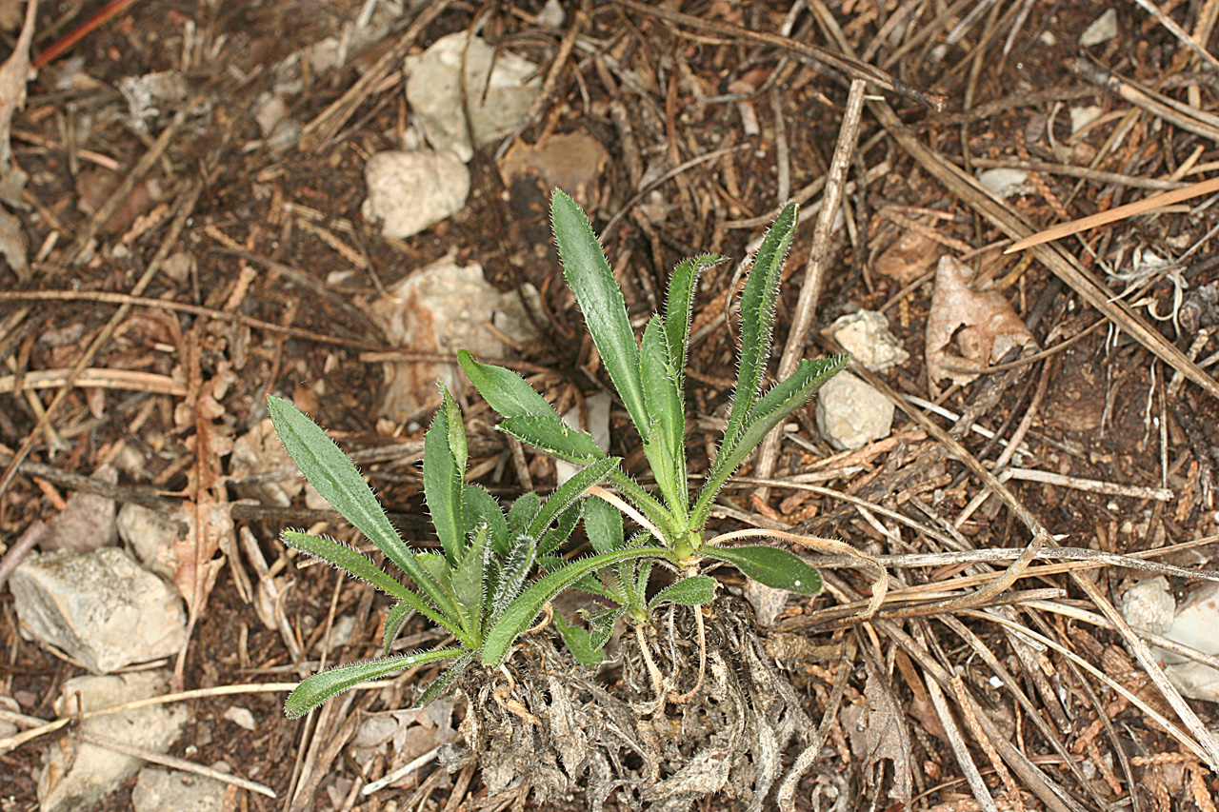
Boechera fendleri– acute leaf apex

Slide 46
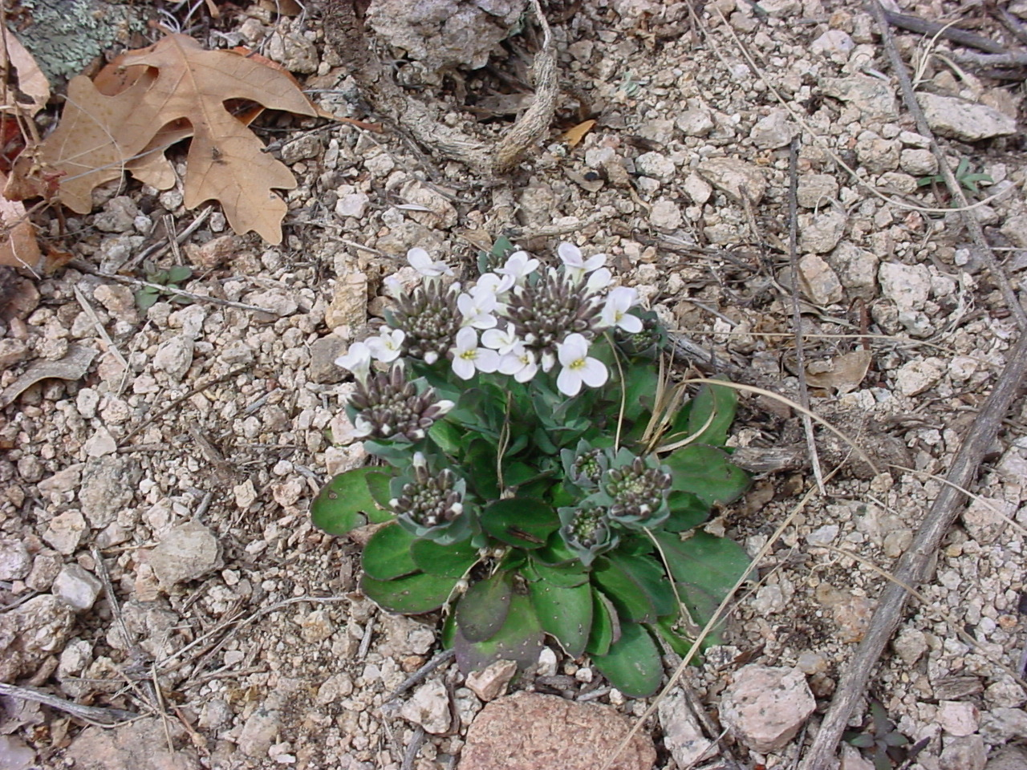
Noccaea fendleri– obtuse leaf apex

Slide 47

Leaf Base

Slide 48

Rumex orthoneurus– cordate leaf base, oblong leaf shape, acute tip

Slide 49

Leaf Margin

Slide 50

Philadelphus microphyllus– entire leaf margin

Slide 51

Quercus gambelii– lobed leaf margin

Slide 52

Penstemon pseudospectabilis– serrate leaf margin, perfoliate stem

Slide 53

Alnus oblongifolia– doubly serrate leaf margin

Slide 54

Thorns, Spines & Prickles
“A” is a thorn, a modified, sharp-pointed stem originating in the leaf axil where a stem usually arises.
“B” is a spine, a modified leaf or part of a leaf such as the petiole or stipule, originating where a leaf usually arises and with a bud in its axil.

Slide 55

Thorn– a modified stem
Koeberlinia spinosa

Slide 56

Stipular Spine– modified stipule
Mimosa aculeaticarpa

Slide 57

Cactus Spines– a special case.
Cactus spines arise in the early deciduous leaf axil in an area termed the areole. However, they are homologous to bud scales rather than to stems and so are not modified stems but rather modified leaves (spines.)

Slide 58
Prickles– they are new epidermal tissue, not “modified anything” and can occur anywhere on stem
Rosa woodsii

